Slide 1
❄
Chiller Technology
COMPARISON & VISUAL ANALYSIS
Old vs. new chiller types · compressor technologies · heat rejection · technology shift
Interactive spider diagram + drill-down comparison package
Old → New shift
Chiller types table

Slide 2
COMPARISON MATRIX
Older vs. Newer Chiller Technology
Key architectural and operational differences across the chiller lifecycle
Aspect | Older chiller technology | Newer chiller technology
Compressor control | Fixed-speed or limited staging | Variable-speed drives, digital control, better staging
Bearings & lubrication | Conventional bearings, oil management required | Magnetic bearings in premium units, oil-free operation
Efficiency focus | Mostly full-load efficiency | Strong part-load efficiency (real-world operation)
Refrigerant | Older CFC/HCFC-era refrigerants | Lower-GWP refrigerants and transition designs
Controls | Mechanical thermostats, basic protection switches | PLC/DDC, sensors, IoT, predictive maintenance
Heat exchanger | Older shell-and-tube, less optimized transfer | Improved exchangers, better surface design
Maintenance | More oil service, more wear, more manual work | Lower maintenance in oil-free / better-controlled systems
Starting behavior | Higher inrush and mechanical stress | Soft start and smoother ramping with VFDs
Plant integration | Mostly standalone equipment | Smart systems, remote monitoring, energy management
Older
Newer
Source: synthesis of standard HVAC chiller technology references

Slide 3
CHILLER TYPES
Complete Chiller Type Comparison
Categorized by generation, drive principle, and heat-rejection form
Category | Chiller type | Generation | Core technology | Main strengths | Main weaknesses
Vapor-compression | Reciprocating | Older | Piston compressor, on/off or staged | Low cost, simple, flexible in small systems | Noisy, vibration, high maintenance
Vapor-compression | Centrifugal | Older–mature | Dynamic compressor with impeller | Large loads, strong full-load efficiency | Low-load / surge risk if not modernized
Vapor-compression | Screw | Mature, common | Twin helical rotors | Reliable, good part-load, fewer parts | Higher first cost, mature not cutting-edge
Vapor-compression | Scroll | Newer mainstream | Spiral scroll, often modular | Compact, quiet, efficient | Limited capacity vs. larger types
Vapor-compression | Oil-free centrifugal | Newer | Magnetic bearings, no oil circuit | High efficiency, low friction, low maintenance | Higher cost, specialized service
Vapor-compression | Turbocor / VSD | Newer | High-speed VFD, oil-free design | Excellent part-load, fast modulation | Complex electronics, premium price
Heat-rejection form | Air-cooled | Traditional | Rejects heat to ambient air via fans | Simple install, no cooling tower | Lower efficiency, ambient-sensitive
Heat-rejection form | Water-cooled | Traditional high-perf | Condenser water + cooling tower | Better efficiency, large-plant fit | More equipment, water treatment
Non-compressor | Absorption | Alternative | Heat-driven refrigeration cycle | Waste-heat / steam, lowers electric peak | Lower COP, larger footprint
System architecture | Modular | Newer concept | Multiple smaller chiller modules | Scalable, redundant, easy expansion | More components to coordinate
Source: synthesis of standard HVAC chiller technology references

Slide 4
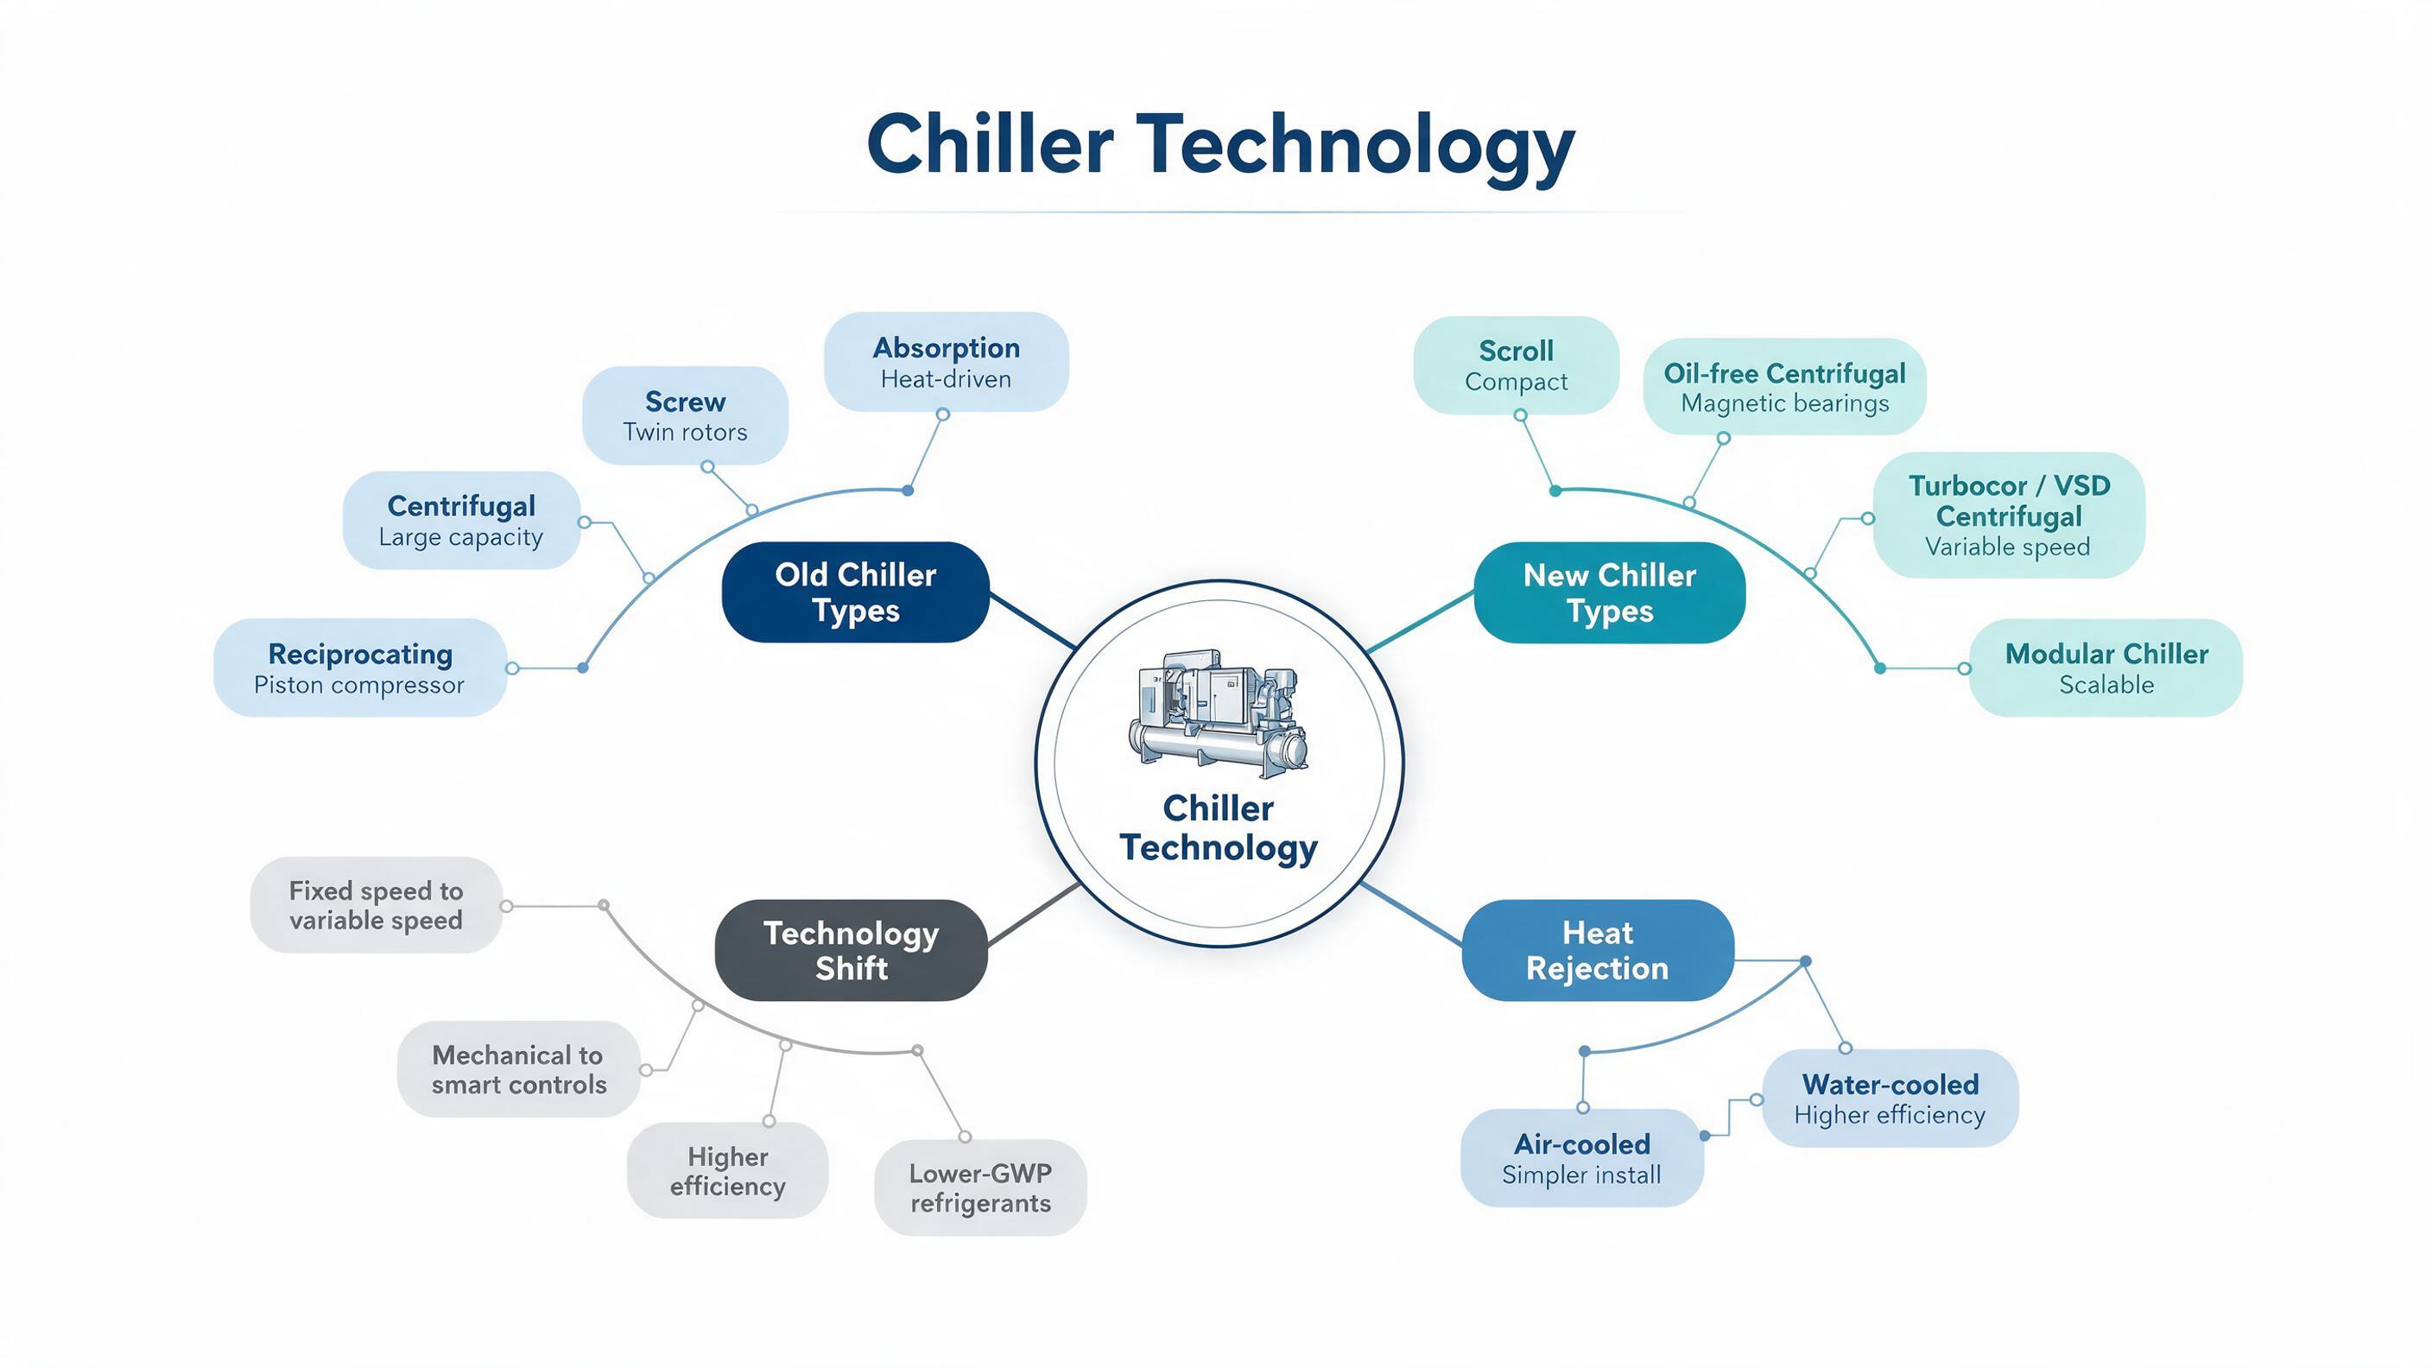
VISUAL OVERVIEW
Spider Diagram — Chiller Technology
Central hub with four branches: Old types, New types, Heat rejection, Technology shift
Each branch connects to sub-nodes representing specific chiller types and technology trends. Use the interactive HTML deck for click-through drill-down.

Slide 5
PAGE 2
Distinct Differences Captured from the Comparison
Four dimensions where old and new chiller technology diverge most clearly
COMPRESSOR CONTROL
OLD: Fixed-speed / staged
NEW: Variable-speed, digital modulation
Reciprocating and older centrifugal systems rely on on/off cycling or limited staging. Newer machines use VSD logic and tighter digital control.
EFFICIENCY FOCUS
OLD: Full-load bias
NEW: Part-load optimization
Newer chillers optimize for part-load, which matters more in real building plants because chillers rarely run at nameplate load all day.
MAINTENANCE PROFILE
OLD: Oil-heavy, more wear
NEW: Oil-free, reduced service
Legacy systems bring more vibration, oil management, and manual service. Oil-free designs reduce friction losses and maintenance points.
SYSTEM INTELLIGENCE
OLD: Basic controls
NEW: Connected, predictive
Modern chillers integrate sensors, alarms, trending, BAS/BMS integration, and analytics so operators can optimize sequencing and diagnose faults faster.

Slide 6
DRILL-DOWN
Old Chiller Types
Mature or legacy-leaning technologies that defined earlier mechanical plants
Type | Core technology | Strengths | Weaknesses
Reciprocating | Piston compressor, staged/on-off | Simple, lower upfront cost, flexible small systems | Noisy, high vibration, more maintenance
Centrifugal | Dynamic impeller compression | Large capacity, strong full-load efficiency | Low-load performance weaker without modern controls
Screw | Twin helical rotors | Reliable, fewer moving parts, good part-load | Higher first cost than reciprocating
Absorption | Heat-driven refrigeration cycle | Waste heat / steam, lowers electric peak demand | Lower COP, larger footprint, complex integration
RECIPROCATING
The piston-era baseline. Strong for simple plants, but pays a penalty in acoustics, wear, and lifecycle service.
CENTRIFUGAL
The classic large-plant machine. Still relevant, but older units are less agile than modern VSD or oil-free variants.
SCREW
The workhorse mature compressor. Common in mid-size buildings — balances size, reliability, and control.
ABSORPTION
A different path, not just an old one. Important when thermal energy is available, not the default for electric plants.
TAKEAWAY
Older chiller technology usually means more mechanical simplicity and sometimes lower capital cost, but also more maintenance exposure and weaker optimization under variable building load.

Slide 7
DRILL-DOWN
New Chiller Types
Newer control philosophy, stronger part-load optimization, better motor speed control
Type | Core technology | Strengths | Weaknesses
Scroll | Spiral compression, often modularized | Compact, quiet, efficient small-to-medium | Not ideal for very large plants
Oil-free centrifugal | Magnetic bearings, no oil loop | Low friction, low maintenance, high efficiency | Higher capital cost, specialized service
Turbocor / VSD | Variable-speed high-speed compression | Excellent part-load, fast modulation, smart sequencing | Higher electronics complexity, premium price
Modular chiller | Multiple smaller units as one plant | Scalable, redundant, easy phased expansion | More modules = more components to coordinate
SCROLL
The compact mainstream option. Favored for rooftops, packaged plants, and modular arrays where footprint matters.
OIL-FREE CENTRIFUGAL
Premium low-friction architecture. Removes oil-management penalties; improves service intervals and heat-exchanger cleanliness.
TURBOCOR / VSD
Modern response to variable-load reality. Strongest improvement is real operating efficiency, not headline full-load numbers.
MODULAR
System architecture as advantage. Useful where redundancy, retrofit space, or staged expansion matters more than one big machine.
TAKEAWAY
Newer chiller technology is defined by control quality, part-load efficiency, reduced oil dependence, and deeper BMS/BAS visibility rather than by compressor shape alone.

Slide 8
DRILL-DOWN
Heat Rejection: Air-cooled vs. Water-cooled
A system architecture choice — not inherently old vs. new
AIR-COOLED
Simpler plant, lower auxiliary complexity
• Rejects heat directly to ambient air using condenser fans.
• Best where water treatment, towers, and condenser loops are undesirable.
• Usually easier to install and maintain, but less efficient in hot ambient conditions.
WATER-COOLED
Higher-efficiency central plant path
• Rejects heat through condenser water and a cooling tower.
• Better suited to large loads, high operating hours, and efficiency-driven plants.
• More components, more treatment, more integration work — but stronger performance at scale.
DISTINCT DIFFERENCE
This is not an old-versus-new distinction by itself — it is a system architecture choice. Older or newer compressor technologies can exist in either air-cooled or water-cooled arrangements, but water-cooled plants usually dominate where capacity and operating efficiency are priorities.

Slide 9
DRILL-DOWN
Technology Shift: Old to New
Four dimensions of the transition from legacy to modern chiller plants
CONTROL LOGIC
Fixed speed
↓
Variable speed
Smoother loading, less cycling stress, better plant matching.
MAINTENANCE
Oil-heavy
↓
Oil-free options
Less fouling and fewer lubrication-related service issues in premium designs.
OPTIMIZATION
Full-load focus
↓
Part-load focus
Modern plants judged by real operating profile, not only design-point performance.
CONTROLS ECOSYSTEM
Standalone
↓
Connected intelligence
Trending, alarms, remote visibility, and BAS coordination become standard.
WHAT THIS MEANS IN PRACTICE
When you evaluate a replacement or retrofit, the real gain usually comes from better sequencing, better part-load response, softer starting, lower maintenance exposure, and better operational data — rather than from changing the compressor family alone.

Slide 10
❄
Key Takeaways
The spider diagram is the navigation map — each node opens full detail
Old ≠ just older manufacture
It means fixed-speed, oil-heavy, full-load-biased, standalone equipment with simpler controls.
New ≠ just newer compressors
It means VSDs, part-load optimization, oil-free options, low-GWP refrigerants, and connected BMS intelligence.
Heat rejection is orthogonal
Air-cooled vs. water-cooled is an architecture choice independent of compressor generation.
Retrofit value is systemic
Real gains come from sequencing, part-load response, softer starts, lower maintenance, and operational data.
Interactive HTML deck · PPTX export · Chiller technology comparison package

